Slide 1














Hands On Making Data Searchable Version 6.3
© ThoughtSpot Inc 2019

Slide 2
Learning objectives
Model data so it’s easy to search
Create and modify worksheets
Create formulas
Create and search a View
Set row level security
Notes:
After loading data, you will create a semantic data model that makes the data easy to search. If we model the data properly, users will have a more seamless search experience. While users can technically start to search the raw data tables that were loaded, it would require them to be familiar with the data and the schema. Also, tables may be loaded into ThoughtSpot that are not relevant to all users. Users in the finance department should only see data related to finance, while the HR department will need access to HR data.
Examples of modeling data for search can be as simple as removing underscores from column names, to creating a formula so it is is accessible to any search in a worksheet. This session reviews how we can model data to make it more searchable. This will include: worksheet design, creating formulas to appear on a worksheet as a column, saving an answer as a view to be later used as a data source, and setting row level security for users.

Slide 3
Model data for search

Slide 4
Types of Data Sources
Name | Definition | Created By
Table | Raw tables loaded by an Administrator | Administrators
Worksheet | Collection of related tables, optimized for searching | Anyone with Can Manage Data
View | Search result saved as a data source. Can be materialized | Anyone with Can Manage Data
User Imported | Table uploaded by a user through the Web browser | Anyone with Can Upload Data
Notes:
To review, searches happen in the context of the selected data sources. Before you start a search, make sure you have the correct data source selected. To begin a new search, you must first select your data sources by clicking on the Choose Sources button. You will see a list of data sources that have been shared with you. The data sources are usually created by your administrator, though you can also upload your own data. ThoughtSpot will also make suggestions from other data sources for you, if what you’re typing can’t be found in the selected data source.
Typically, end users only access worksheets and any data that they import.

Slide 5
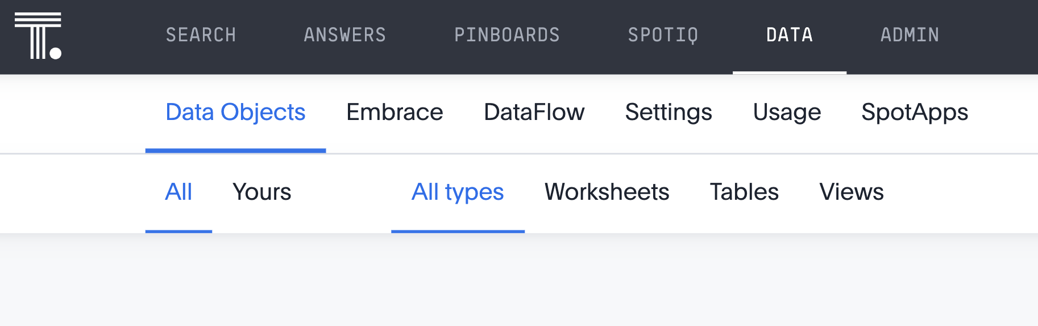
View the data
The Data Objects tab of the Data page lists all tables and data sources available to you. You can apply stickers to data sources for easy retrieval.
Notes:
The Data tab lists all of the tables and data sources available to you. The most commonly used data sources for searching are worksheets.
You may filter data sources by All or Yours, or by type of data source. You can apply stickers to data sources for easy retrieval, and filter by sticker.

Slide 6
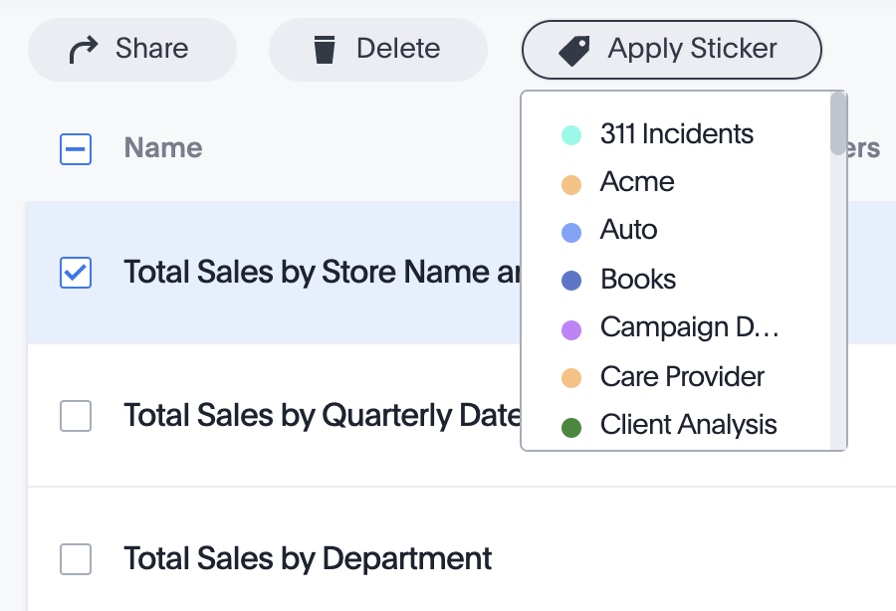
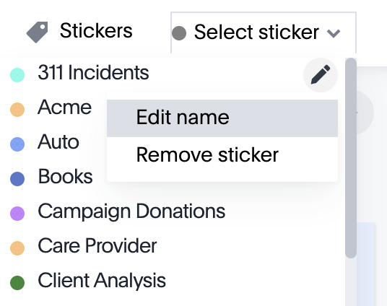
Using Stickers
You can use stickers to make it easier to find objects in ThoughtSpot! Everyone can see them, and you can use them to tag Answers, data sources, and Pinboards.
Notes:
You can create stickers to make it easier for people to find data sources, Answers, and Pinboards. Stickers are global in scope. This means that everyone can see the stickers and use them to tag objects. They can also filter lists of objects by sticker. Stickers are often used to designate subject areas, such as sales, HR, and finance, but you can use them any way you like. Whenever you are selecting objects from a list, you can filter by sticker to find what you’re looking for.
Only administrators can create stickers, while anyone can apply a sticker and filter by a sticker. To create a sticker, navigate to the Data or Pinboards screen using the icons on the top navigation bard. Choose the Select Sticker dropdown, and select +Add. You can change the name of a sticker by clicking the edit icon next to its name. You can change the color of a sticker by clicking the color circle next to its name.

Slide 7
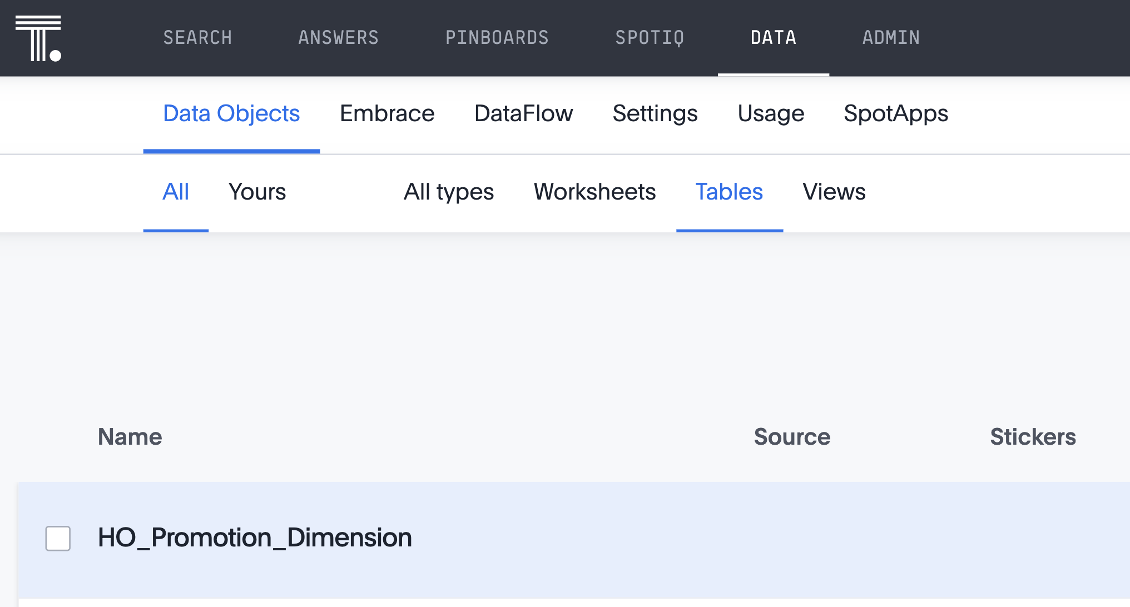
Data management
In the Data tab, you will find a list of all data sources. You can configure a table to make columns easier to search on. Open up a data table to see data management options.
Notes:
There are many ways we can configure a table for search. You can change settings in two ways, both of which change the data model. If you want to make a few small changes, you should make them in the ThoughtSpot application, as is described in the following slides. If you want to make many changes, you can edit the modeling file, which is covered later in the deck. Whether you are changing data modeling settings using the modeling file or the web interface, the settings and their accepted values are the same.

Slide 8
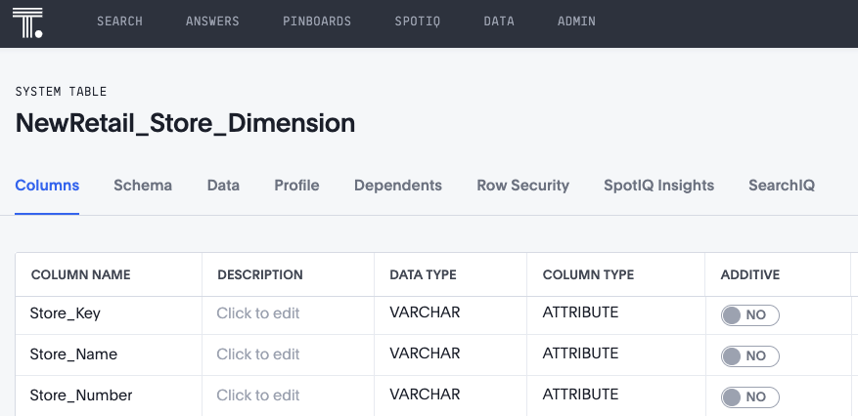
Explore Data Management: Table and Worksheet settings
Open a table, and view the Columns tab. Here we can edit various data modeling settings, either on the table or worksheet level.
Settings can be applied to both tables and worksheets
Notes:
The following settings can be changed for both tables and worksheets. As a best practice, make any data modeling settings in the table when you will be creating multiple worksheets that use that table. This way, you won’t have to make the same settings in each worksheet. The settings will be inherited when you create worksheets that uses columns from the table.
If you have settings that only apply in the context of a particular worksheet, make those settings in the worksheet rather than in the underlying table(s).
Note that if you make your settings at the table level, and then create a worksheet that uses columns from the table, the settings are inherited from the table at the point in time that the worksheet is created. If you then go back and change the settings at the table level, your changes will not be reflected in the worksheet.

Slide 9
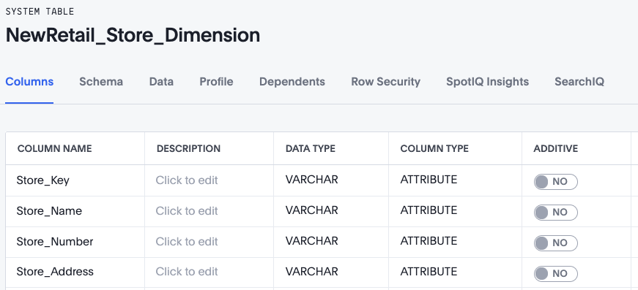
Data Management: Column Name, Description, Data Type
There are quite a few ways you can model your data for search!
You can change the Column name to something more intuitive, and even add a text Description of what the column contains.
Notes:
You can change the Column Name for any column by clicking on the column name within the table, and editing within the text box that appears. Common changes to Column Names include the removal of underscores or unnecessary words. Users search by column name within ThoughtSpot, so it’s important that Column Names are intuitive and descriptive to the data they contain.
Description allows you to add even more text description of what the column contains. This information will appear when a user hovers over a column name from the left data panel, or a user can navigate to within the table to view all column descriptions.
The Data Type column is read-only, and shows the data type of each column as set by the SQL DDL.

Slide 10
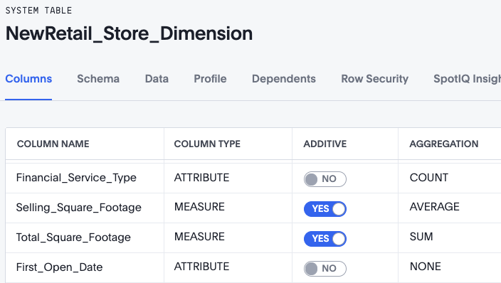
Data Management: Column Type, Additive, Aggregation
You can change the Column Type to either Attribute or Measure, indicate whether it is Additive, and set the default Aggregation.
Notes:
Column Type is inferred from the data type, and is either an Attribute or Measure. Attributes are text or date values, while Measures are numeric values that you can do math on. Not all numeric values should be treated as Measures though, and you are able to change the Column Type on the table or worksheet. For example, IDs or Keys are treated as descriptors, or Attributes. They should be changed to Attributes.
The Additive column controls the type of aggregations that will be available for a column. Much of the time, Attributes will be Non-Additive as they will not be used for aggregation. Even if a column is not set as Additive, there are still some aggregation that can be done. For example, the keywords such as “count” can be used with Attributes.
To aggregate a column without having to enter the aggregation type explicitly in your searches every time, you can set a default Aggregation for that column. Setting this default can make combining data more intuitive.
Keep in mind that not all Measures should be aggregated. Consider a table containing data about athletes on a sports team. The data contains some numerical values, including points scored, salaries, and jersey numbers for each of the players. Because jersey number is an Integer, it would become a column of type Measure (not Attribute). So it will aggregate, by default. But you may want to make its aggregation type None instead.

Slide 11
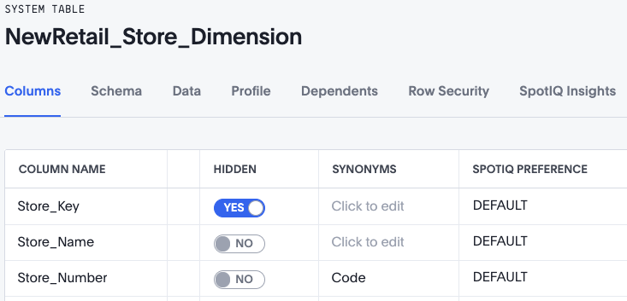
Data Management: Hidden, Synonyms, SpotIQ Preference
You can Hide columns from users, enter Synonyms, and specify if you want to exclude columns from SpotIQ analysis.
Notes:
Hidden sets the visibility of a column. Any columns that a user will not search on can be Hidden from them. The column does not disappear from the underlying data table, but users will not be able to search on it.
Synonyms let you take into account some variability in how users will want to search something. Adds synonyms that can be used in the search bar to refer to a column. You can add synonyms that are the column name in a different language to account for language variability. Another example is to add “sales” as a synonym for “revenue”. You can add as many synonyms as you’d like, separated by a comma.
SpotIQ Preference indicates whether that column will be included in SpotIQ analyses. By default, all columns are included in SpotIQ.

Slide 12
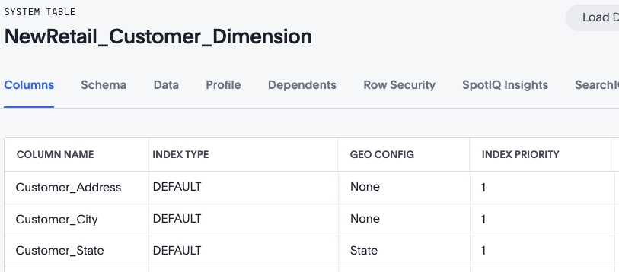
Data Management: Index Type (Suggestion Indexing)
ThoughtSpot dynamically indexes Search bar suggestions for column names and values. You can control whether and how ThoughtSpot suggests column values.
Notes:
A column’s Index Type controls whether and how ThoughtSpot suggests column values. You can set the Index Types as the following:
DEFAULT: The default behavior applies to all ATTRIBUTE columns. PREFIX_AND_SUBSTRING for short values and PREFIX_ONLY for long values and free-form text.
DONT_INDEX: Prevents indexing on columns; column doesn’t appear in search suggestions.
PREFIX_AND_SUBSTRING: Allows full indexing such that prefix and sub-string search both work for the column values.
PREFIX_AND_WORD_SUBSTRING: Allows indexing such that only prefix search works for each word of a multi-word string, for the column values.
PREFIX_ONLY: Allows indexing such that only prefix search works for the column values.

Slide 13
Data Management: Index Priority (Suggestion Indexing)
A column’s Index Priority determines the order or rank in which it and its values appear in the search dropdown. Higher values as Index Priority.
Notes:
A column’s Index Priority determines the order or rank in which it and its values appear in the search dropdown. By default, the Index Priority value is set to 1 for all columns. You can push a column up in the order (increase the rank) by increasing its Index Priority value. A higher value (like 2) will cause the corresponding column and its values to appear higher up in the search dropdown than columns with lower value (like 1). You should only use numbers between 1-10 in the Index Priority field. Use a value between 8-10 for important columns to improve their search ranking. Use 1-3 for low priority columns. Changing the Index Priority should be done with caution, as these values impact the dynamically calculated Usage Based Ranking (UBR).

Slide 14
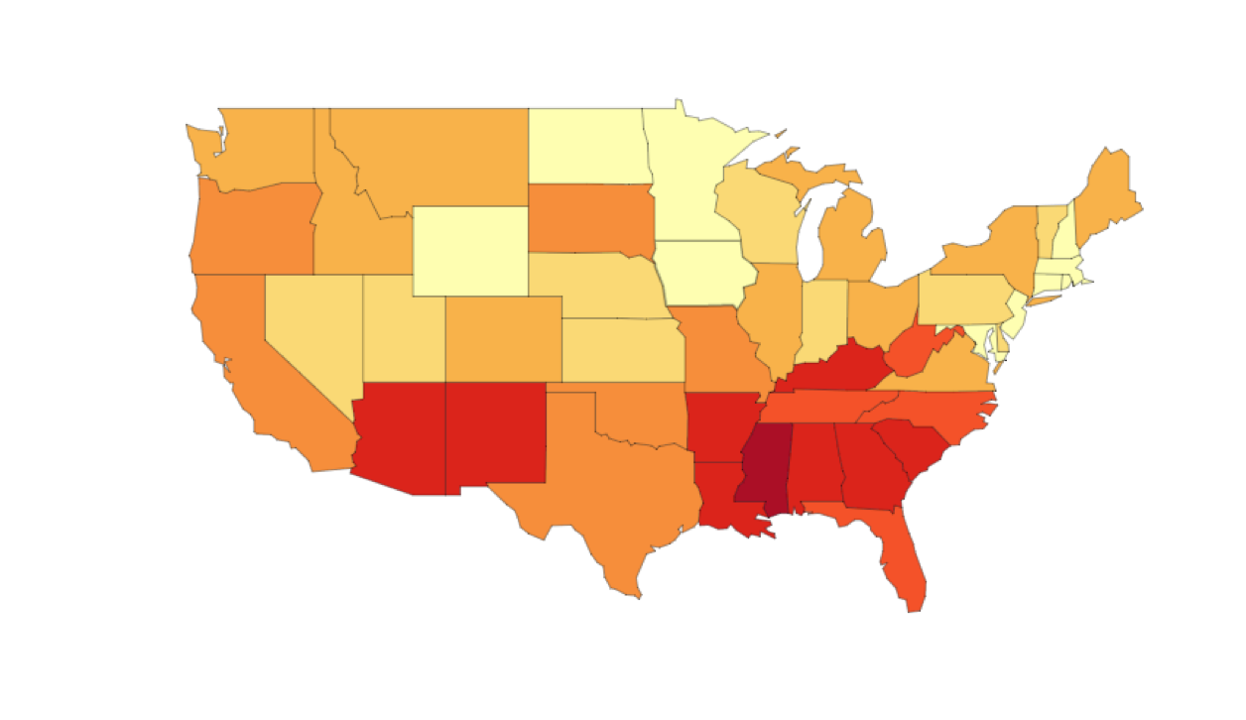
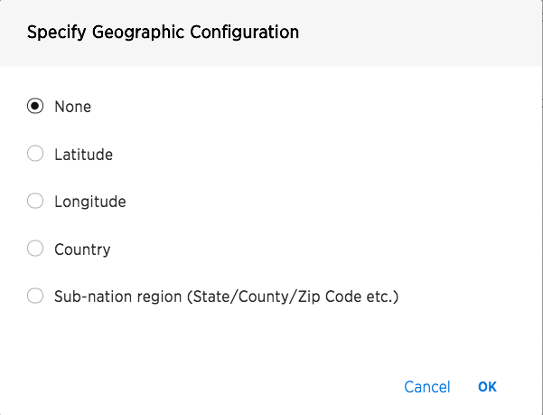
Data Management: Geo Config
The Geo Config allows a column to be used in GeoMap visualizations. This step is needed so maps can be shown!
Notes:
Certain attribute columns that contain location data can be used to create GeoMaps. ThoughtSpot supports Latitude, Longitude, Zip Code, US States, US Counties, Countries, and select international sub-nation regions. With version 6.2, ThoughtSpot now supports Portugal and India in its list of countries in which the sub-nation regions are available for mapping. While a sub-nation region must be selected for borders within a map to be shaded, any location with a latitude and longitude may be mapped in visualizations such as heat or bubble maps.
Ensure the geographical data values match the one supported by ThoughtSpot. The complete list of supported geographical data can be found here : https://docs.thoughtspot.com/latest/reference/geomap-reference.html

Slide 15
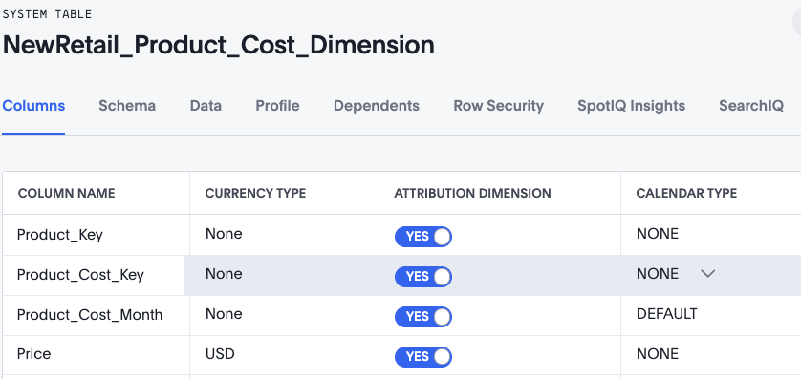
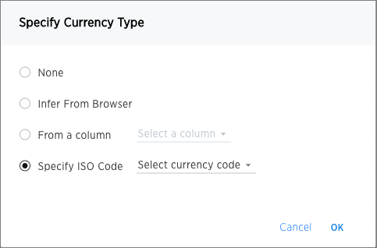
Data Management: Currency Type
You can set a format for how currencies display in tables and charts. For example, you can display currencies in a standard European Euro or US Dollar format, based on the data modeling setting Currency Type.
Notes:
You can specify if you’d like to use the currency type from the locale identified by the location of your browser, from existing currency information in another column, or from a specific ISO code.

Slide 16
Data Management: Attribution Dimension
Attribution Dimension setting only applies to tables that join over a chasm trap. When Attribution Dimension is set as “No”, it indicates that the table is not to be used to resolve a chasm trap.
Notes:
The Attribution Dimension setting applies only to tables that are related through a chasm trap. If your schema does not include these, you can ignore this setting.

Slide 17
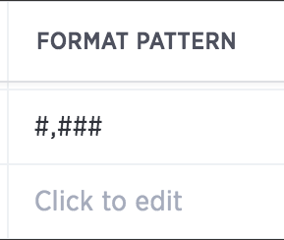
Model the Data for Search: Format Pattern
Format Pattern allows you format how numbers are displayed in tables and charts. The table below shows examples of format patterns for various display value types.
Stored Value | Format Pattern | Display Value
12345.6789 | #,##0.## | 12,345.68
12345.6789 | #,##0.### | 12,345.679
12345.6789 | #,##0.00000 | 12,345.67890
12345.6789 | #,##0 | 12,345
12345.6789 | #,##0.00 | 12,345.68
12345 | #,##0.## | 12,345
12345 | #,##0.00 | 12,345.00
Notes:
You can set a format for how numbers are displayed in tables and charts. For example, you can display numbers with a different number of digits after the decimal point, based on the data modeling setting Format Pattern. You can use any of the supported number formats for delimiters and number of digits to show using Java Decimal Notation. Currency symbols are not supported.

Slide 18
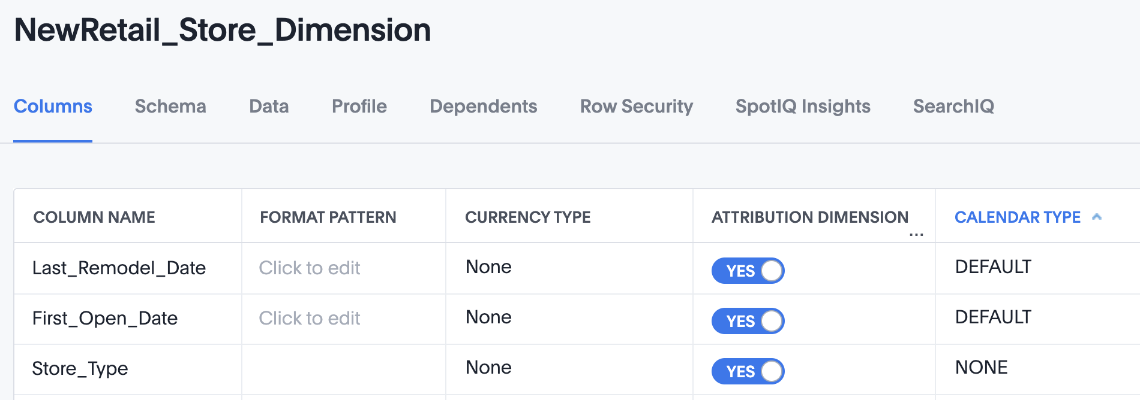
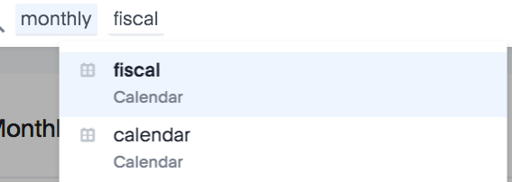
Model the Data for Search: Calendar Type
Calendar Type specifies what type of calendar a date type column uses. It can be a Gregorian calendar (default), a fiscal calendar, or any custom calendar.
You can override the default calendar in the search bar.
Notes:
Custom calendars enable customers to make use of all the rich date-related keywords and function in ThoughtSpot , even with their highly customized calendars.

Slide 19
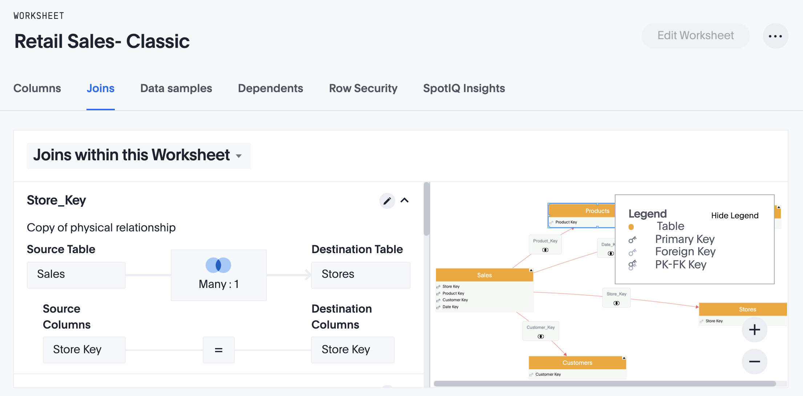
Explore Data management: Joins tab
The Joins tab of a worksheet allows you to edit the join rule. Change the join type or join cardinality here.
Notes:
When you create a worksheet, you select a join rule. The joins defined within the worksheet determine how the tables that make up the worksheet are joined, and how those joins behave when searching on the worksheet. You are not limited to just one join rule for the entire worksheet. You can define different types of joins for each join between tables in a worksheet. By default, each of these individual table joins uses an inner join. But you can override this at the individual join level. You must have either the Can administer ThoughtSpot privilege or the Can manage data privilege to modify joins within worksheets.

Slide 20
Making Data Searchable: Best Practices
There are a number of ways you can configure tables and worksheets to create an easier search experience for your users:
Rename columns
Add a Description
Convert keys to attributes by updating Column Type
Hide columns
Add Synonyms
Set a Currency Type
Set Index Priority
All the modeling settings are detailed in the Documentation site, https://docs.thoughtspot.com/6.3/admin/data-modeling/data-modeling-settings.html#.

Slide 21
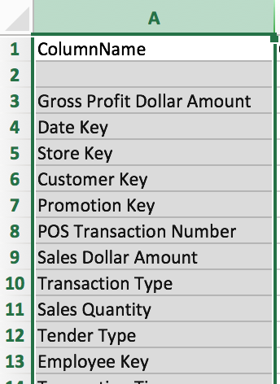
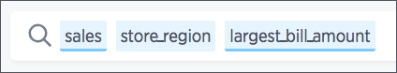
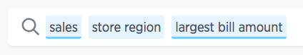
Best practices: Update column names
Column names with spaces instead of underscores provide a more natural search experience

Slide 22
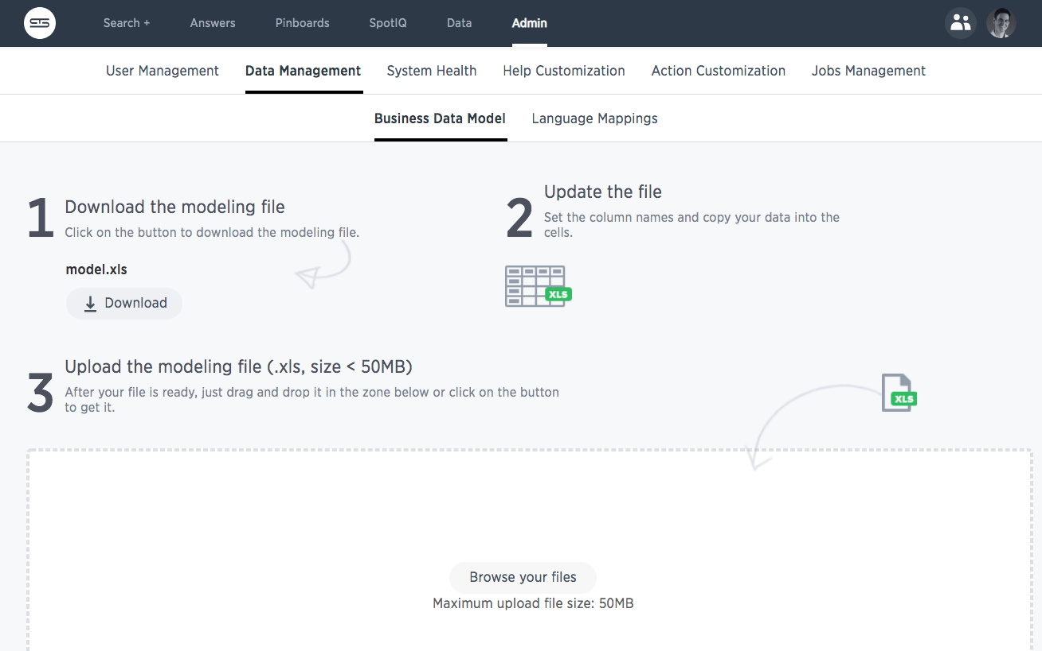
Making changes to data model in bulk: Download data modeling file
In addition to modifying each table individually in the browser, you can also make bulk changes by downloading, editing, and uploading the data model file.
Notes:
You change data model settings in bulk by using the data modeling file if you have access to the Admin > Data Management page. Editing this file allows you to view and edit all the system data columns. When you add new data to your system, this file changes as it expands to accommodate new data columns.
The data formats you use in your system are controlled by the modeling file, an Excel file. To make these changes you download the model file, change the model, and upload your changes back into the system. In each row of the modeling file, all the data properties corresponding to a column from your data are listed. You can modify many of these properties by typing in the new value.
Do not modify any value in a column which contains DoNotModify in the field under the column heading. Make sure to keep the file in the same format as it had when you downloaded it. The model file contains a row for each column in your data set. You can change all or a subset of rows. You can edit the file to leave the heading rows and only those rows you want to change. This can make the file more convenient to work with.

Slide 23
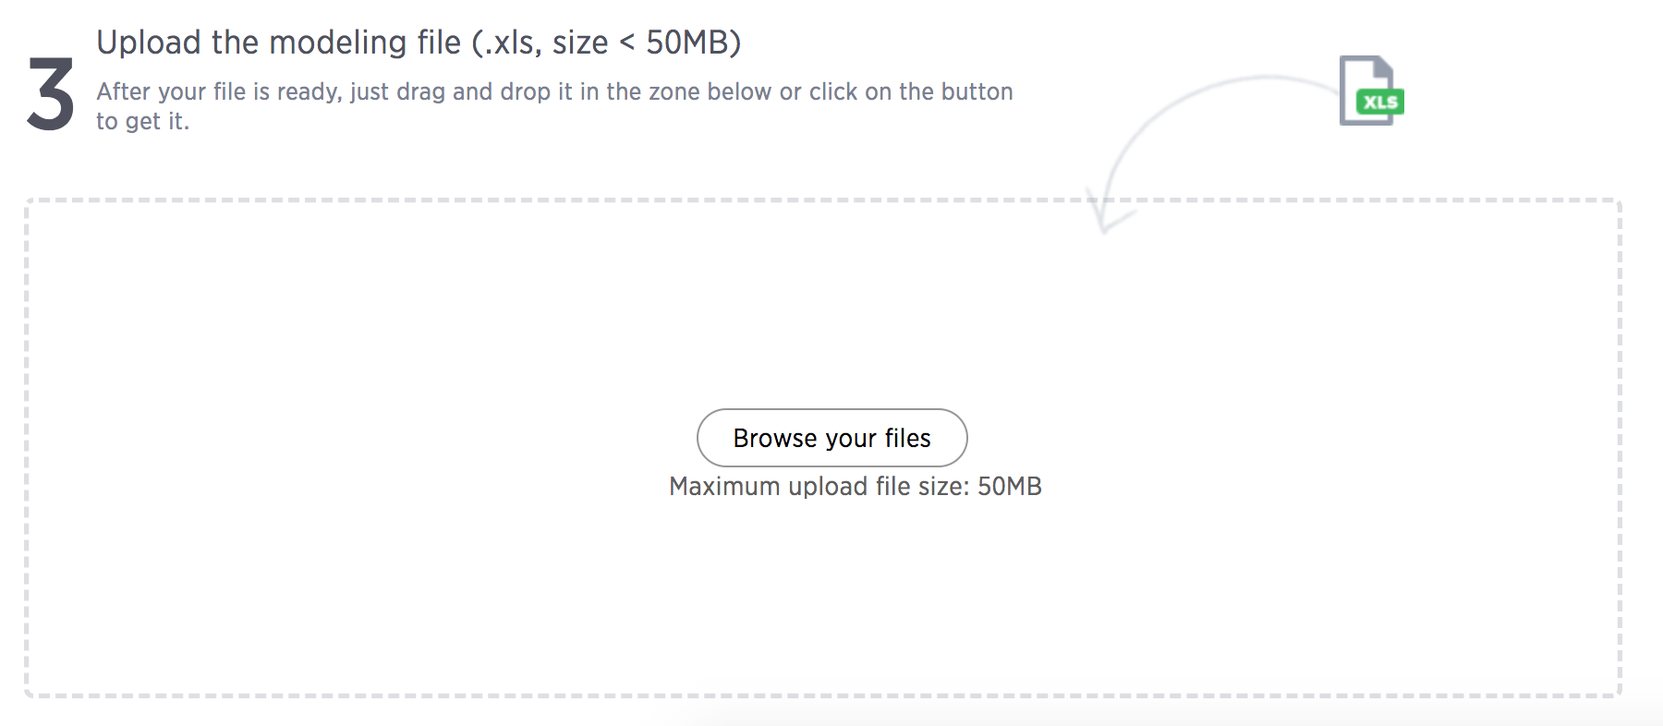
Making changes to data model in bulk: Upload the modified model
Save the model file (ignore the warning about CSV). Upload it.

Slide 24
Scriptability

Slide 25
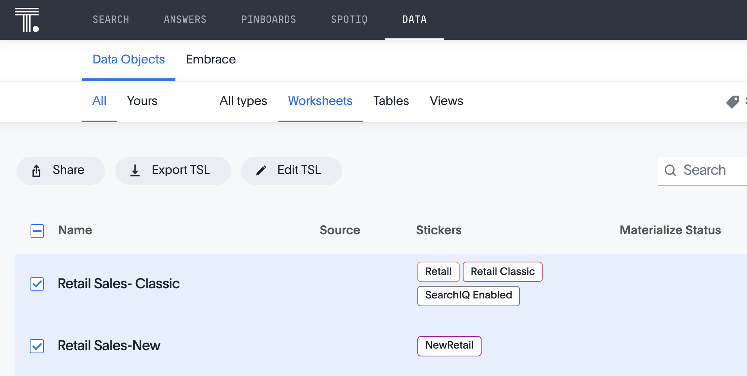
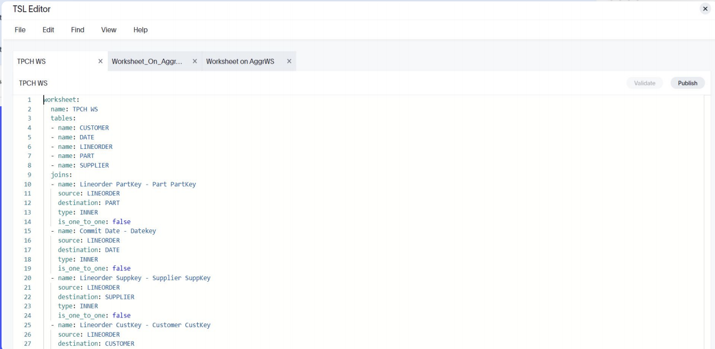
Scriptability Overview
Use ThoughtSpot's Scriptability to migrate or edit Worksheets, Pinboards, Answers, Views, and tables in a human-readable format.
Migrate from development to production environment easily
Implement metadata changes outside the ThoughtSpot UI
Make bulk changes
Reuse existing objects to build new ones
Notes:
Scriptability offers the following features: 1) Download objects in a human readable format, 2) Edit the file outside of ThoughtSpot, 3) Migrate these objects to a different environment, 4) Use edited file to create a new object or update an existing one

Slide 26
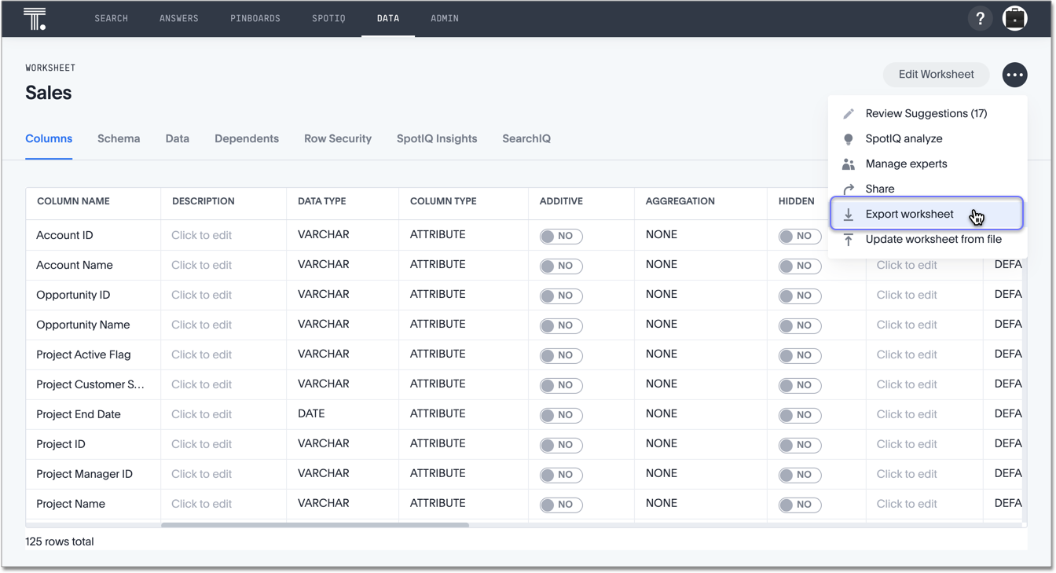
Scriptable Worksheets
You can download Worksheets to a flat file, modify the file, and subsequently upload this file either to the same cluster, or to a different cluster.
Notes:
Scriptable Worksheets support metadata migration from development to production environments, enables changes that are not possible within the user interface, and lets you perform bulk changes to the metadata (renaming, duplication).
You can now Export Worksheets by downloading them to a .tsl file, make changes, and then Update the Worksheet from the changed file either to the same cluster, or to a new cluster.

Slide 27
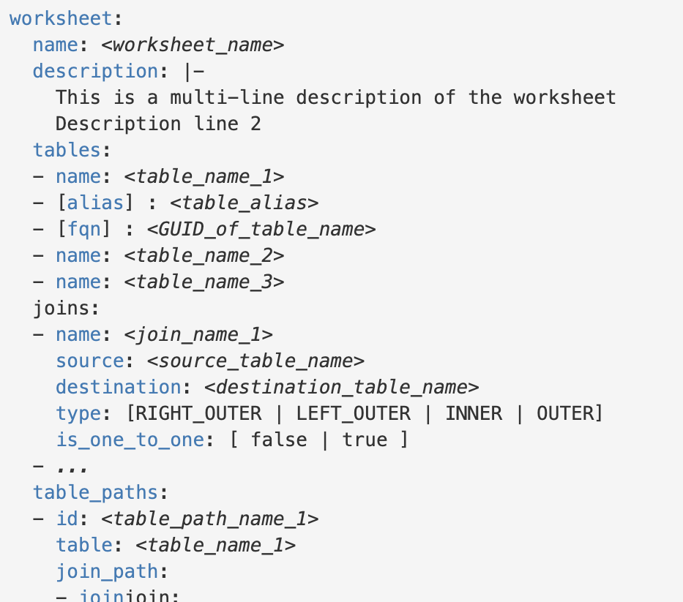
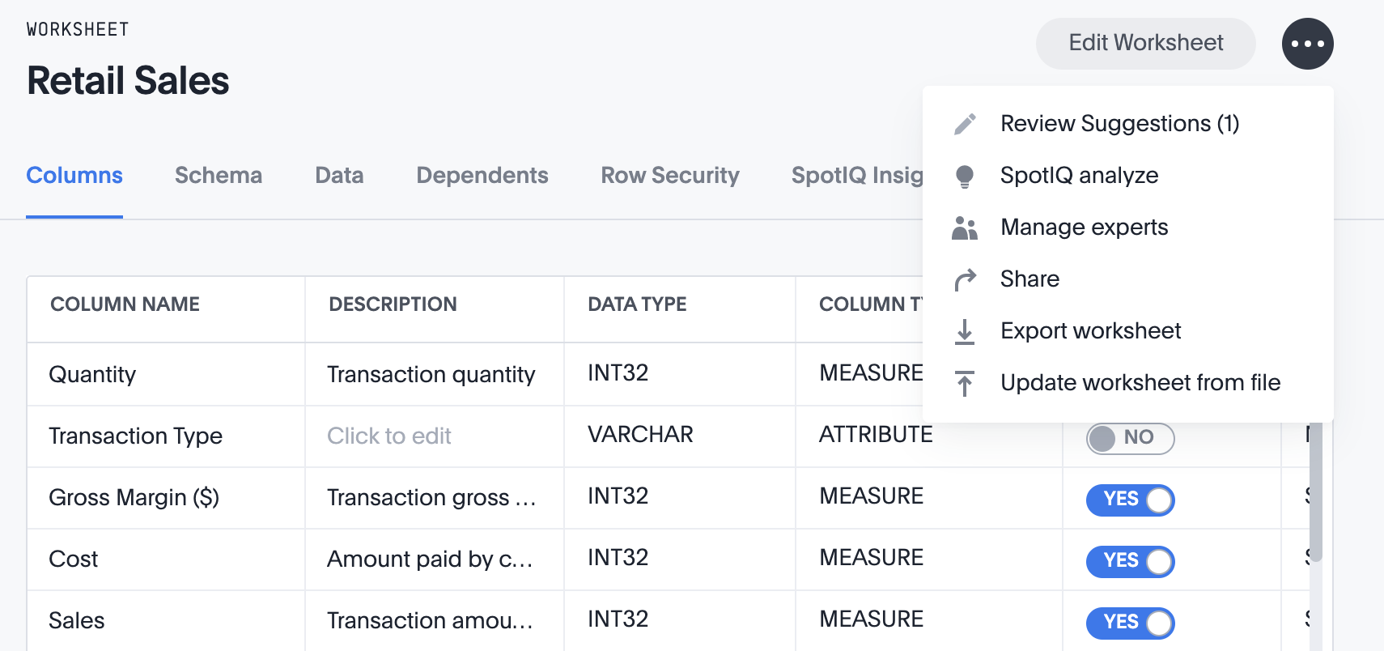
Scriptable Worksheets (cont.)
Modify the file to make edits to a Worksheet, and then upload into ThoughtSpot through the UI.
Notes:
The .tsl file for Scriptable Worksheets has a specific syntax. Please see a description of parameters at our documentatio site. Keep in mind that Formulas and columns can either have a new name, or a new expression. You cannot change both, unless migrating or updating the worksheet two times.

Slide 28
Scriptable Answers and Pinboards
Scriptability is also available for Answers and Pinboards.
These are “human readable” files, or TSL files.
answer:
name: Demo answer
tables:
- id: Copy of TPCH WS
name: Copy of TPCH WS
table_paths:
- id: Copy of TPCH WS_1
table: Copy of TPCH WS
join_path:
- {}
search_query: '[Revenue] [Year] [Commit Date] = ''last 40 years'''
answer_columns:
- name: Commit Date
- name: Year
- name: Total Revenue
table:
table_columns:
- column_id: Year
headline_aggregation: COUNT_DISTINCT
- column_id: Total Revenue
headline_aggregation: SUM
ordered_column_ids:
Sample of Answer TSL file (continues)
Notes:
TSL files for Answers and Pinboards, much like Worksheets, can be opened in an editor of choice. These files are human readable, and can be edited, saved and imported back into ThoughtSpot. Scriptability makes it easy to move objects from a development to a production environment, or edit single or multiple objects quickly.

Slide 29
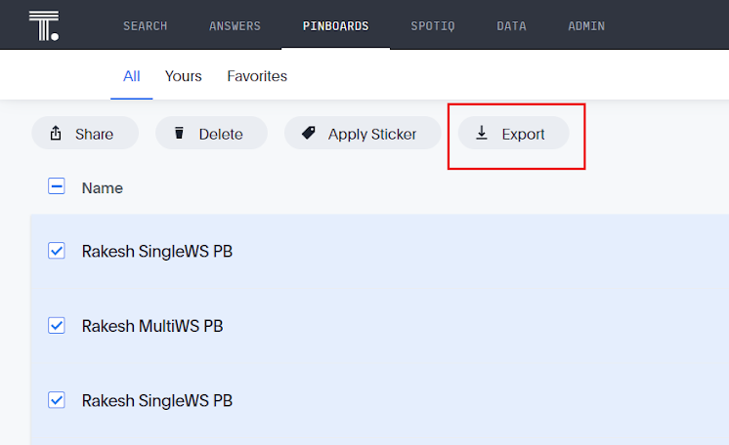
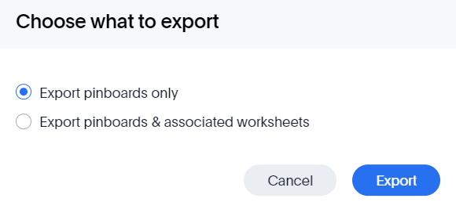
Exporting Pinboards
Pinboards can be exported individually, or you may select multiple Pinboards in the Data page to export. Select whether you also want to export the associated Worksheets.

Slide 30
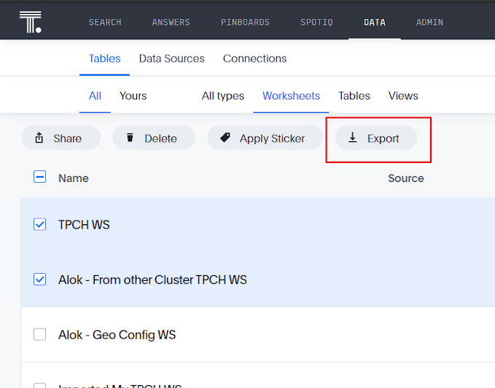
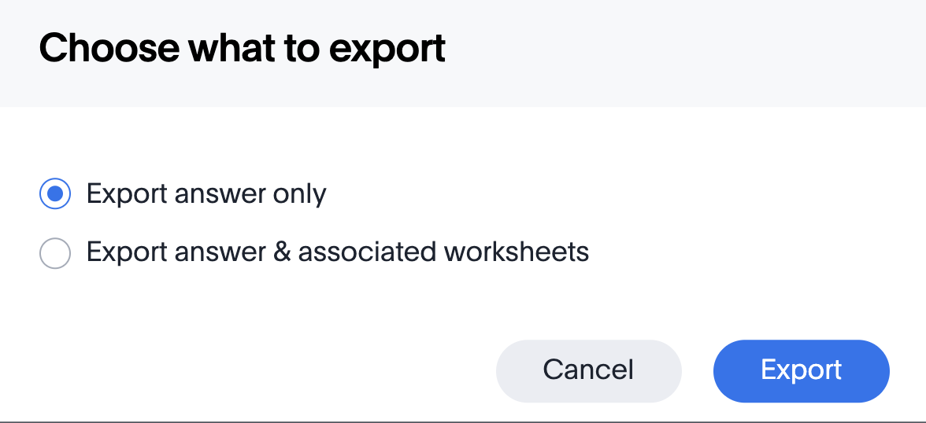
Exporting Answers
One or multiple Answers can be exported as a TSL file. Choose whether you’d like to export just the Answer, or the Answer and associated worksheets.
Import the updated TSL file back into ThoughtSpot to easily create new objects from file.

Slide 31
Create a Worksheet
Notes:
Worksheets are flat tables created by joining columns from a set of one or more tables or imported datasets.
After modeling the data, create worksheets to make searching easier. For example, a sales executive might need to search for information about retail sales. The required data could be contained in several tables (sales, customers, products, stores, etc.), with foreign key relationships between them. An administrator who is familiar with the data model can create a retail sales worksheet, that combines all of the related fact and dimension tables into a single, easy-to-use view, and share it with the sales executive. This provides access to the data without requiring an understanding of how it is structured.
Users are often unfamiliar with tables and how they are related to one another. A worksheet groups multiple related tables together in a logical way.

Slide 32
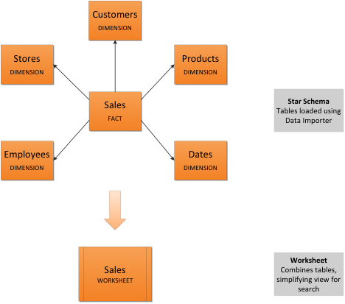
Guidelines for Worksheets
Typically, you create one worksheet for each set of fact and dimension tables. For example, you may have a sales fact table and an inventory fact table. Each of these fact tables shares common dimensions like date, region, and store. In this scenario, you would create two worksheets: sales and inventory. The following diagram depicts the workflow for creating the sales worksheet.
Notes:
The process for creating a worksheet is:
Decide which tables to use for the worksheet
Create a new worksheet
Add sources (tables) to the worksheet
Choose the worksheet join rule
Select the columns to include
Optionally modify the join types within the worksheet
Optionally create formulas or worksheet filters
Save the worksheet
Share the worksheet

Slide 33
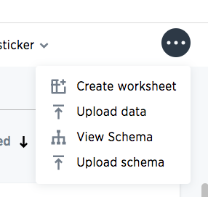
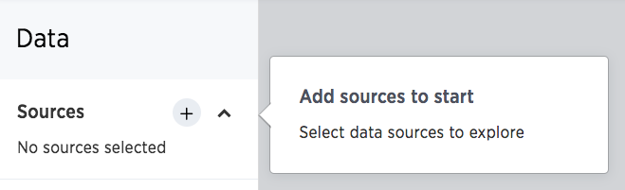
Create a Worksheet
Go to Data, click the ellipses icon, and select Create Worksheet.

Slide 34
Add Sources and Columns to Worksheet
After creating a worksheet, you need to add the sources that contain the data. Sources is another name for tables. The sources you choose are typically related to one another by foreign keys.
Select columns from each data source. You can change the column names here.

Slide 35
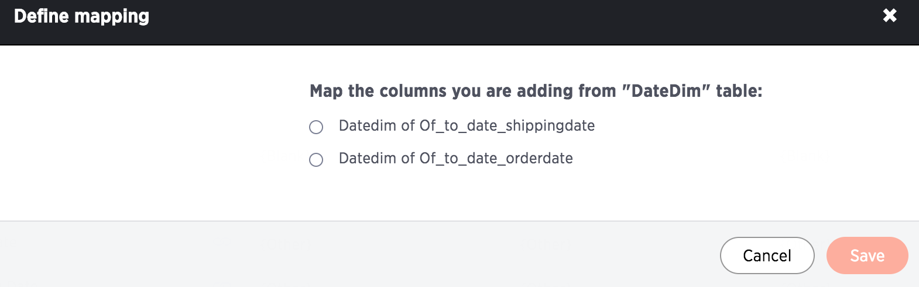
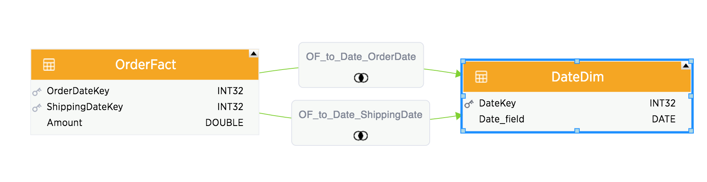
Create a Worksheet
If there are multiple possible join paths, choose the one you want to use.
Notes:
When you create a worksheet, you select a join rule. The join rule works together with the joins defined within the worksheet determine how the tables that make up the worksheet are joined, and how those joins behave when searching on the worksheet.

Slide 36
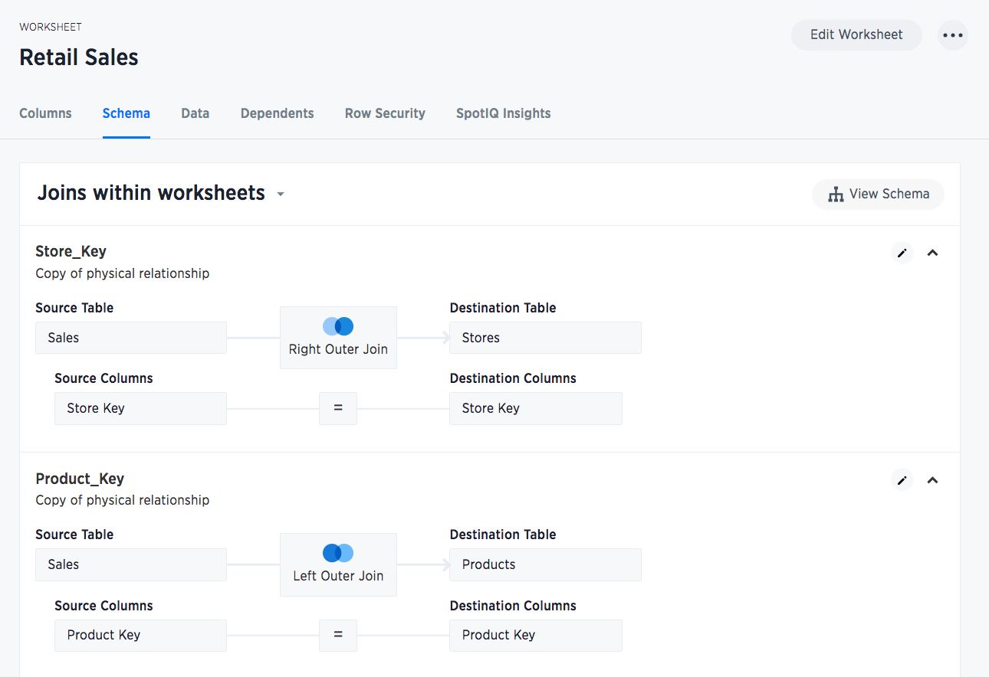
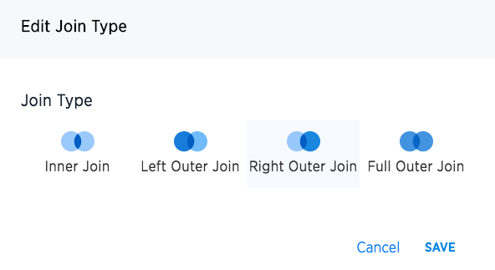
Joins within worksheet
Notes:
Starting with ThoughtSpot version 5.0, you are not limited to just one join rule for the entire worksheet. You can define different types of joins for each join between tables in a worksheet. Be default, each of these individual table joins uses an inner join. But you can override this at the individual join level.

Slide 37
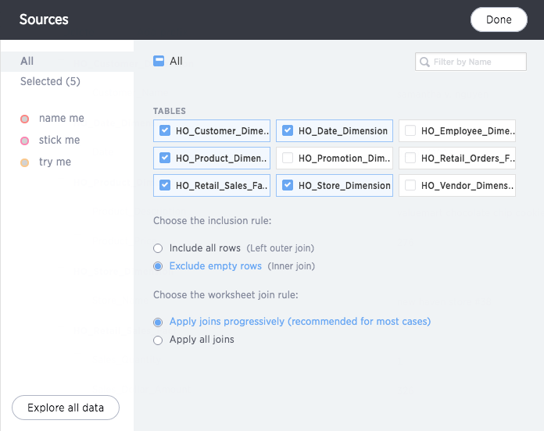
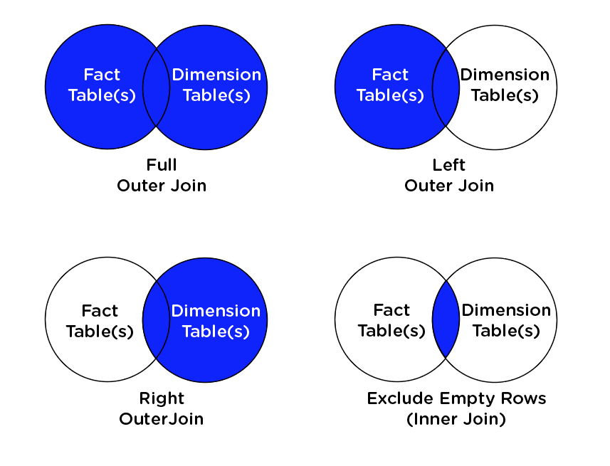
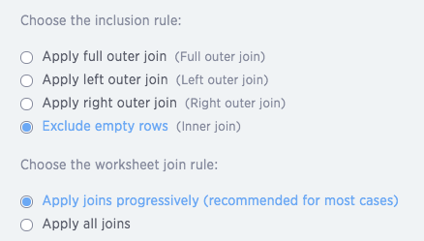
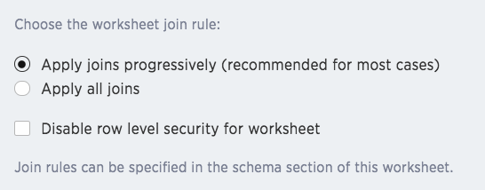
Create a Worksheet
Choose the worksheet join rule
Notes:
Often, a worksheet includes several dimension tables and a fact table. With progressive joins, if your search only includes terms from the fact table, you can see all of the rows that satisfy your search. But as you add terms from dimension tables, the total number of rows shown may be reduced, as the joins to each dimension table are applied. It works like this:
If you choose Apply joins progressively (recommended for most cases), joins are only applied for tables whose columns are included in the search.
If you choose Apply all joins, all possible joins are applied, regardless of which tables are included in the search.
When using Apply joins progressively, the number of rows in a search using the worksheet depends on which tables are part of the search. The worksheet acts like a materialized view. This means that it contains the results of a defined query in the form of a table. So if a particular dimension table is left out of the search, its joins are not applied.

Slide 38
Add Formulas
Notes:
You can define formulas and use them to create derived columns in worksheets.

Slide 39
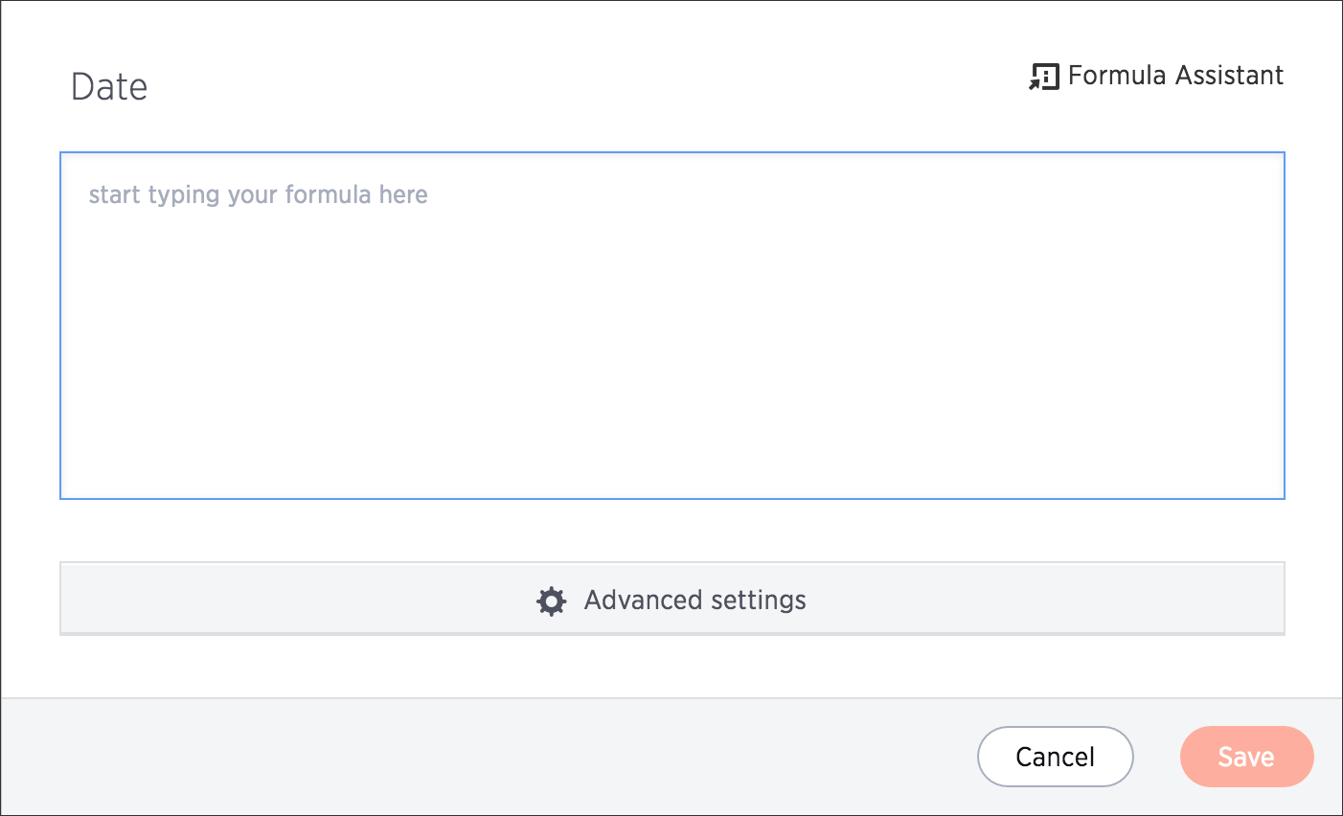
About Formulas
Formulas allow you to create a derived column in a worksheet.
You can define formulas and use them to create derived columns in worksheets.
Notes:
You create formulas by combining standard functions and operators, column names, and constant values. You can use formulas to calculate things like gross profit margin, costs of goods sold, and other common calculations. Anyone who can create a worksheet can add a formula to it. Formulas are not reusable; the formula you create is associated only with the worksheet it belongs to.

Slide 40
Two Kinds of Formulas
Formulas | Aggregation Formulas
Act on individual rows and return one result per row. | Combine rows together and return a single result.
Examples: add, subtract, multiply, divide, contains, if...then...else | Examples: Cumulative sum, moving average, standard deviation

Slide 41
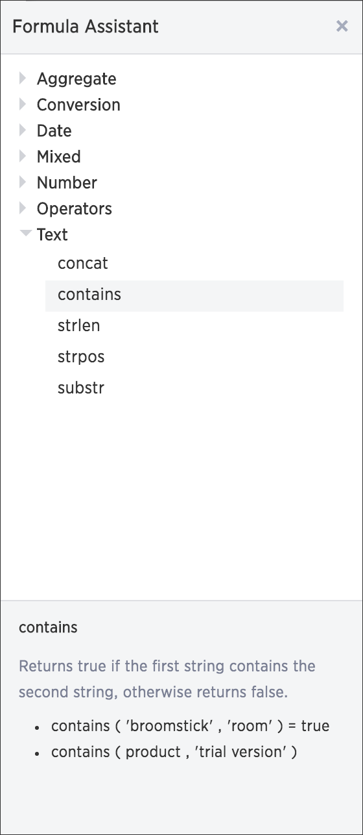
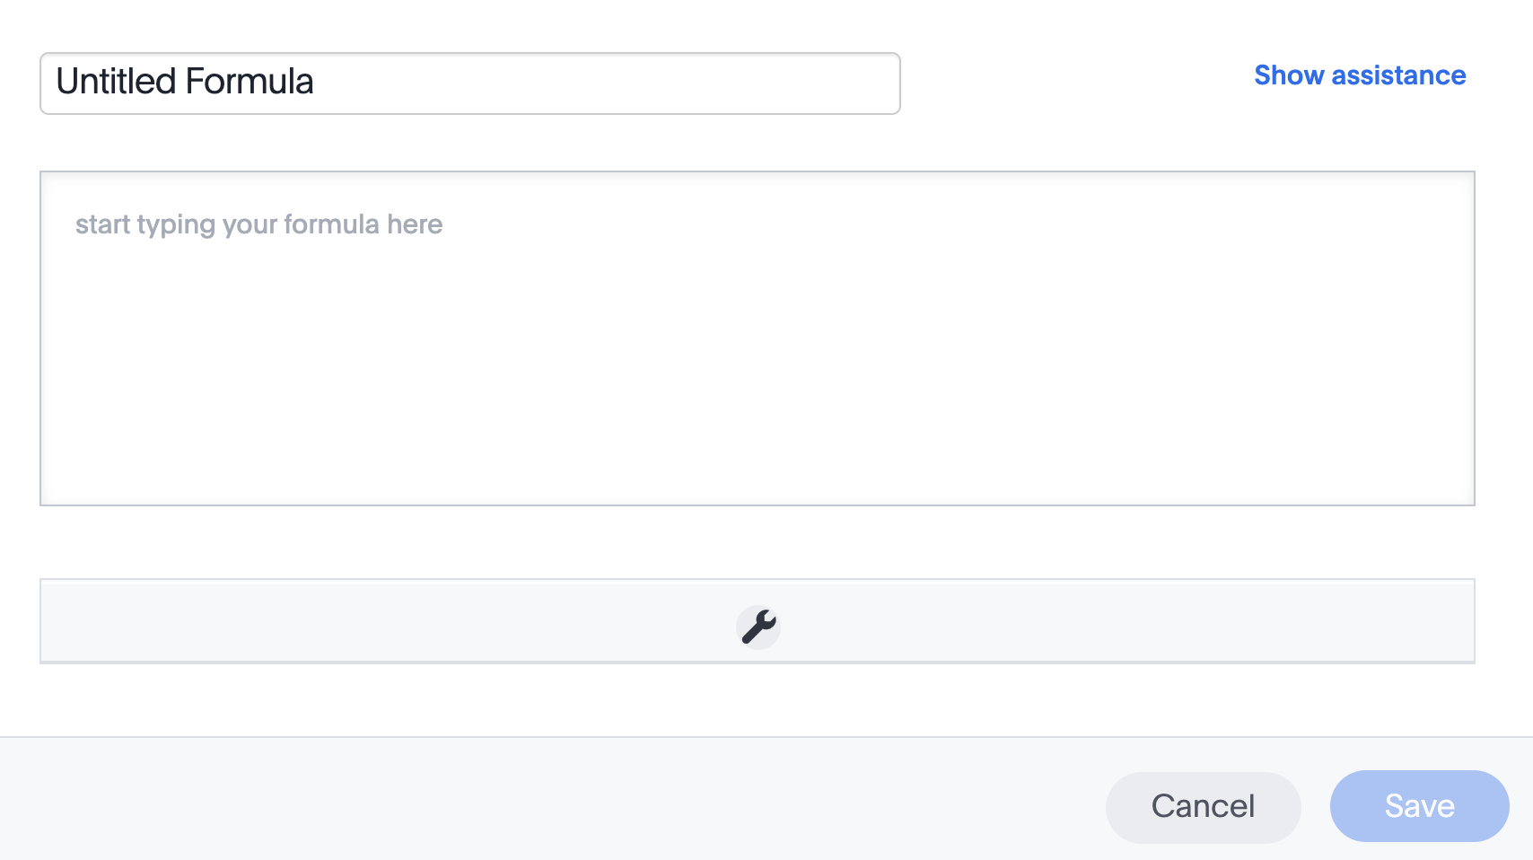
Add a Formula to a Worksheet
Click the + next to Formulas.
Bring up the Formula Assistant.

Slide 42
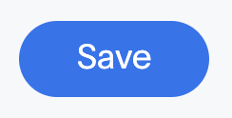
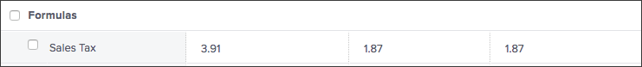
Add a Formula to a Worksheet
Let’s say you want to calculate a 8.5% sales tax on each sale.
Add the formula to calculate the tax:
sales dollar amount * .085
Name your formula “Sales Tax” and save it.
View the sample values.
Your Work!
Notes:
An example of a formula that creates a derived attribute would be as follows:
if ( customer_age >= 18 and customer_age < 30 ) then '18-29' else if ( customer_age >= 30 and customer_age < 50 ) then '30-49' else if ( customer_age >= 50 and customer_age < 65 ) then '50-64'
else if ( customer_age < 18 ) then ’Under 18' else '65+'
An example of formula in which aggregating operator must be defined:
To calculate % gross margin use formula sum ( profit ) / sum ( sales ) * 100
If you don’t use sum() in front of each value in the formula, the division operation happens for each row and then gets aggregated. Usually you want to sum up the rows first and then do the division. This formula forces that order of operations.

Slide 43
Custom Calendar
Notes:
By default, ThoughtSpot’s fiscal calendar begins on January 1st. If your company’s calendar starts on a different date, you can use a custom calendar to ensure date searches in ThoughtSpot reflect your fiscal calendar. Common use cases of custom calendars include retail calendars, such as 4-4-5 or 4-5-4; pharmaceutical companies that want the week to run Friday through Thursday; and, fiscal calendars starting on different calendar days in each year.

Slide 44
Custom Calendar
Custom Calendar enables customers to setup a highly-customized calendar, and make use of all the rich date-related keywords and functions in ThoughtSpot.
Functionally is similar to creating a very specific date dimension, and performing date calculations on it.
Notes:
When you create a custom calendar, you designate the month, day and year on which your company’s fiscal year begins and ends. When using your custom calendar, searches like this quarter or q3, conform to the fiscal quarter defined by the calendar. Existing worksheets, tables, views and pinboards also reflect that calendar. When you add a custom calendar, be sure to alert your users of the change and how it affects both current and saved searches.

Slide 45
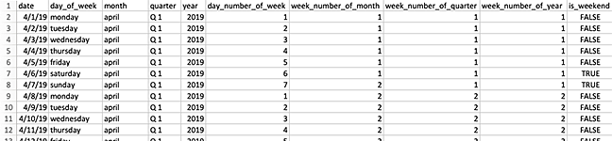
Using Custom Calendars – Date File
Enable Custom Calendar
Generate the date file from tscli
tscli calendar generate --start_date --end_date --calendar_type {MONTH_OFFSET,4-4-5,4-5-4,5-4-4}
--start_day_of_week
Notes:
First, custom calendars must be turned on using an advanced tscli command. Work with ThoughtSpot Support to enable this feature. Using a calendar template as your starting point ensures that you use a format that is compatible with ThoughtSpot.
The maximum scope of date dimension is 90 years.

Slide 46
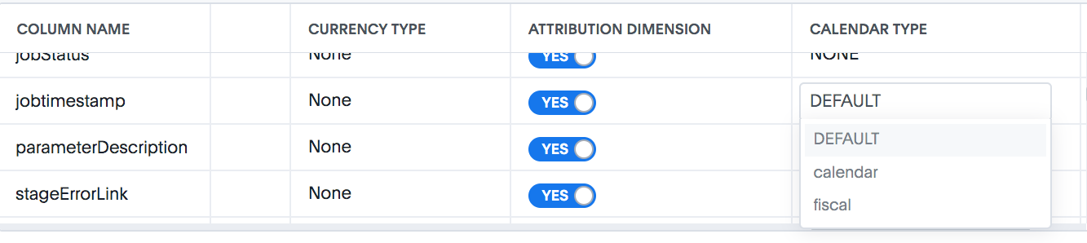
Using Custom Calendars – Date File (cont.)
Upload the date file
tscli calendar create --file_path Date.csv --name Retail-Calendar --username tsadmin
Notes:
On the worksheet or table, there is an additional column Calendar Type, and for each column you can select the calendar type. you can also set it up on cluster level.

Slide 47
Dependencies

Slide 48
Dependencies
ThoughtSpot objects stack. You are not able to delete an object that has dependents. For instance, you cannot delete a table that has worksheets created from it.
SpotIQ
Answers & Pinboards
Worksheets & Views
System Tables

Slide 49
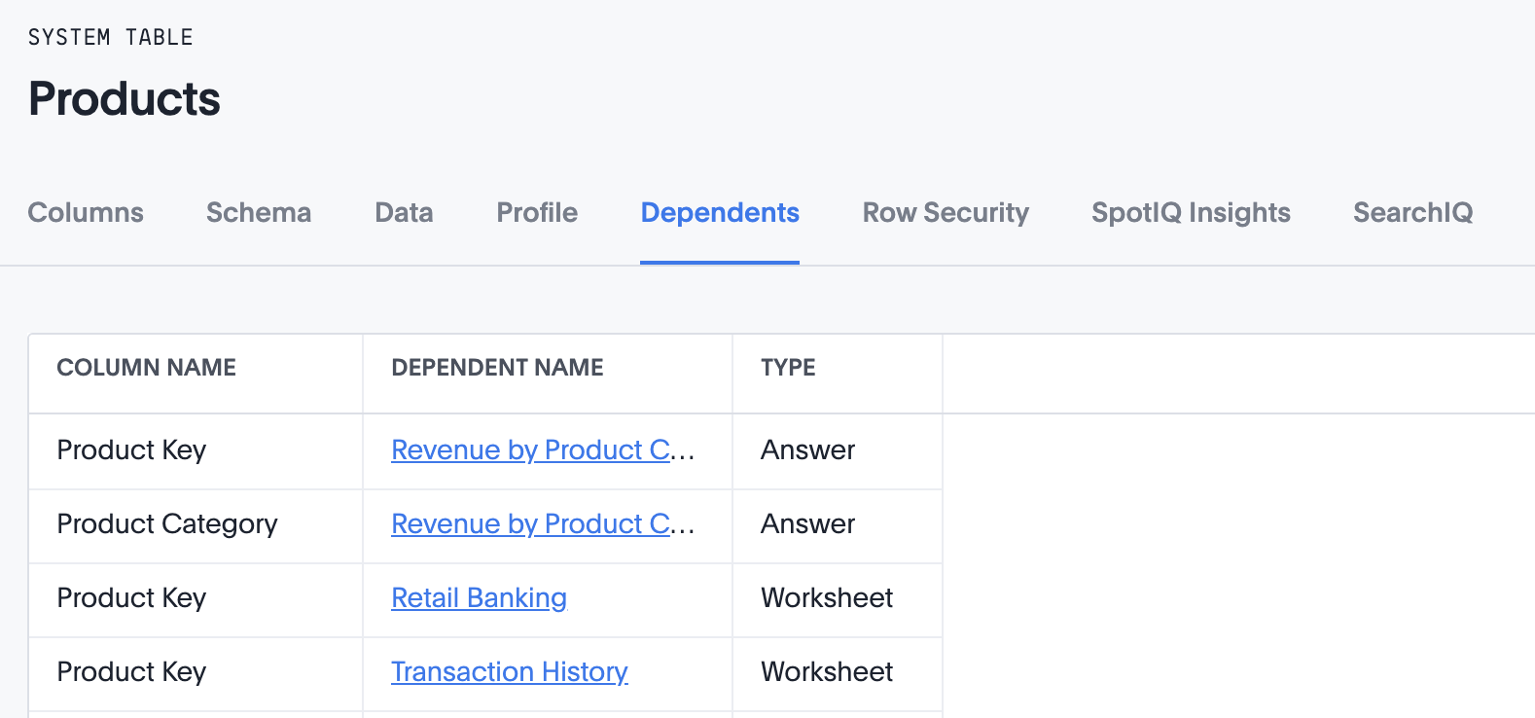
Dependencies
ThoughtSpot will warn you if you try to delete an object with dependents. You must delete all dependents first! From the Data page, open a table, and click Dependents to see a list of all dependents for an object.

Slide 50

Dependencies
If you attempt to delete a worksheet, you’ll see a list of dependent answers and pinboards. Remove dependencies, and you will be able to delete the worksheet.
Notes:
When all dependencies have been deleted, only then can you delete the original object.

Slide 51
Views & Materialized Views
Notes:
If you want to search on top of another search, try saving your search as a view. Then, you can use the saved view as a data source for a new search. Prior to ThoughtSpot version 5.0, Views were known as Aggregated Worksheets. When you upgrade to version 5.0 or later versions, any pre-existing Aggregated Worksheets will be converted to Views for you automatically. The functionality remains the same, but the name has changed.

Slide 52

Views
When you want to do a search on top of another search...
Notes:
You can save an Answer as a View by selecting Create View from the ellipses icon of an Answer.

Slide 53


Materialized Views
Speed up performance by pre-computing the data and storing it in memory.
Notes:
You may want to materialize the View, to improve its performance when searching. Views can become slow as your data volume and the number of views stacked on top of one another grow. This happens because when doing a search, each view is computed on the fly. To improve the performance of a view, you can materialize it. Materializing pre-computes the view and stores it in memory, just like a table.
The number of materialized views you can create is limited to 50, because materialized views take up space in memory.
Row Level Security does not apply to materialized views. All users will see the same data when using the materialized view as a data source.

Slide 54


Materialization Status
Notes:
You can check the materialization status of your view.

Slide 55


Materialized Views
Notes:
Your view can become stale, if it isn’t refreshed when the data in the tables used to create it is updated. There are two ways to refresh the data: 1) manually refresh data in a view, or 2) refresh the View on a schedule.

Slide 56


Dematerialize Views
Free up space in memory, or delete a view you no longer need.

Slide 57
Managing Experts
Notes:
Using the Ask the Expert feature can be particular useful in the following scenarios:
User struggles to create a chart or table: User may be confused about a data model, or may not be proficient with ThoughtSpot search. They know what business insight they are looking for, but cannot create the correct chart or table to answer their question.
User wants to validate a chart or table: User already created a chart or table, but wants an expert to validate it before they take business decision based on it.

Slide 58


Ask an expert- Manage Experts
Ask An Expert requests go to the person (or people) in your company who know the data source well, and how to search on it in ThoughtSpot.
Administrators can add Expert(s) to any data source.
Notes:
Adding an expert is what enables Ask an expert to work in your ThoughtSpot instance. Until you do these steps, users won’t see the prompt to Ask an expert when using that data source.

Slide 59

Ask an Expert- Manage requests
See status, requestor, modified
Filter by Resolved | Unresolved
Click to navigate to the associated chart or table, and resolve it
Notes:
Experts are notified via email when a user Asks an Expert a question. If the Expert does not have an email set up in ThoughtSpot, he or she can view requests by navigating to Answers, clicking the ellipses icon, and choosing View Requested Answers. If the requester has an email address in ThoughtSpot, an email will be sent to them with a link to the answer.

Slide 60
Row Level Security
Notes:
Using row level security, you can restrict data that appears in ThoughtSpot objects, by group.

Slide 61

Types of Security
Login Security
LDAP / SAML
Object level security
Sharing as Edit or View
Applied to users and groups
Column Security on Tables
Ability to share specific columns with users and groups
Row Level Security
Tables show different data, depending on who is viewing them
Notes:
We have covered several different types of security in this training. Now, we will discuss data-level, or Row Level Security.

Slide 62
Row Level Security (RLS)
Row level security (RLS) allows you to restrict a group’s access to table row data. You do this by creating a rule that associates a filter with a group.
Row level security is applied through expressions that you create.
RLS does not apply to Administrators; they can always see all rows in all tables
RLS applies to underlying data tables, and is therefore applied everywhere else- Answers, Worksheets, Pinboards, and search suggestions.
Notes:
When a group member searches, views an Answer, or otherwise works with data, ThoughtSpot evaluates the rules and prevents the display of the restricted data. Users see only the data they are permitted to see. The security rules apply to objects shared with users individually or through groups they are a member of.

Slide 63
Row Level Security
RLS is applied through expressions, similar to formulas; when they evaluate ‘true’ for a row, the user can see that row.
There are special variables that allow us to set RLS rules!
ts_groups: Returns all groups a logged in user is a member of. If any of those groups can see a particular row, it will be shown to the logged in user.
ts_username: Works the same, but for individual users

Slide 64


Adding Row Level Security
To add RLS, navigate to the Data tab, click the table name, and select Row Security.
To add an RLS rule, navigate to the Data tab, click on the table name, and select Row Security.

Slide 65
Adding Row Level Security
Here you can enter a rule, that when returns ‘true’, the user or group can see data for that row.
Example, if a user is in a group called West, and an RLS expression is created store_region = ts_groups , then users in this group will only have access to see data for the West region.
Notes:
Row Level Security is “self-maintaining” in that, as long as your expression still works with new data and group, you don’t need to update it. If a user is a member of multiple groups, the user can see all the rows that are visible to all of their groups. The most permissive policy is used.

Slide 66
Tools to Drive Adoption

Slide 67

Scheduled Pinboards
Automate email updates to stakeholders.
Note that you need to have the privilege “Can schedule pinboards” in order to do this exercise.
Notes:
You can schedule a pinboard job for any pinboard by using the Add a schedule prompt page. You can add multiple schedules with different configurations for a single pinboard. However, each job is limited to one pinboard schedule. To add a schedule, you must either be an administrator or have the schedule pinboard privilege, and at least edit-only and view-only access to the pinboard.

Slide 68


Scheduled Pinboards

Slide 69


Scheduled Pinboards
Configure the day, time, and frequency for sending the pinboard in email.

Slide 70


Scheduled Pinboards
Gating Condition
Notes:
You can add a gating condition (feature is in beta). Write a statement that returns a single boolean value (true or false). For example, sum (revenue) > 100 is a valid condition but is_weekend (commit_date) is not. You can use any valid formula in your statement. Other than checking your formula syntax, ThoughtSpot does not validate your formula returns a single boolean.
At the scheduled time, ThoughtSpot checks the gating condition, and, if the condition returns true, processes the pinboard.

Slide 71


Learn Pinboard
Notes:
The Learn Pinboard contains search replays created in the system.

Slide 72


Add to Learn Pinboard
Click the pin icon.
Add to the pinboard called Learn how to use ThoughtSpot
Notes:
Any administrator can add to the items in the Learn center. To add a replay, do the following:
Search in your search bar.
Choose the pin from the answer that results. The system lists the pinboards you can pin to.
Select Learn how to use ThoughtSpot pinboard.

Slide 73


Custom Help
You can customize ThoughtSpot Help to be specific to your data, examples, and documentation. You can add links to your data dictionary, training schedule, or internal resources!

Slide 74


Custom Help
When you click on Help, you see a list of links. Administrators can remove or add additional links to this list.

